Slide 1
Data-Driven Insights for Digital Marketing Campaigns

Slide 2
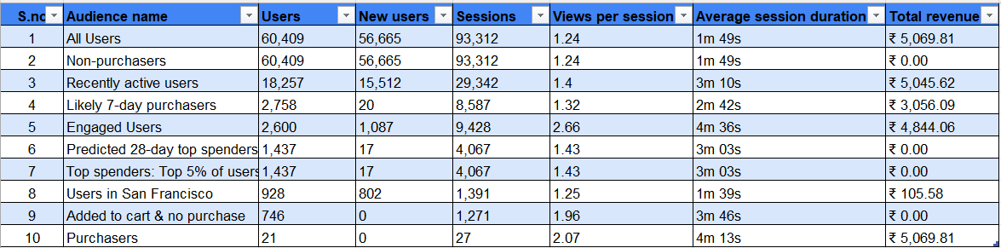
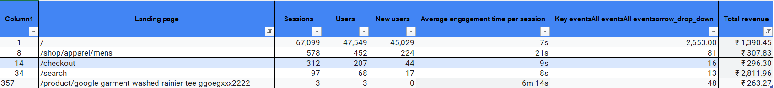
Task-1: Data Analysis- Clean and preprocess the data

Slide 3
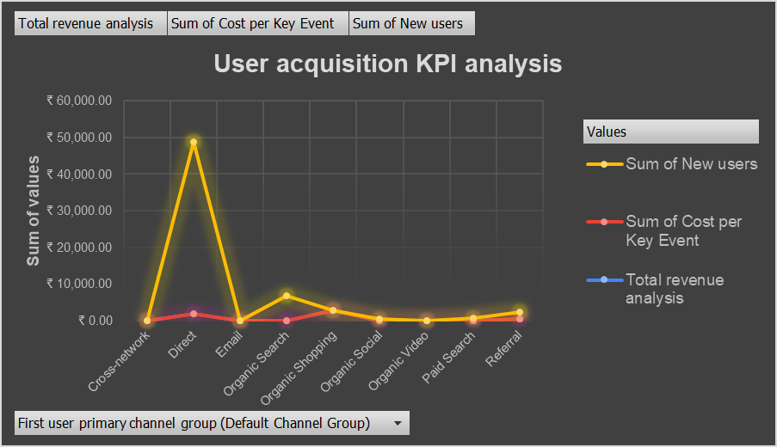
Identify key performance indicators (KPIs) and benchmarks for campaign performance

Slide 4
Key Insights:
📈 Direct Channel drives the highest number of new users (~₹50,000), far surpassing other sources.
📉 Email and Referral channels show moderate new user acquisition with relatively higher cost per key event.
🔻 Organic Search & Organic Shopping deliver a balanced performance with decent new user counts and lower cost per event.
📉 Cross-network, Organic Video, Paid Search contribute the least across all metrics.
📊 Total Revenue appears low and steady across all channels—implying user quantity ≠ revenue quality.

Slide 5
💡 Recommendations:
Optimize Direct channel further—it’s a high-conversion source.
Review ROI for Email and Referral due to high cost per key event.
Invest more in Organic Search if aiming for cost-effective growth.
Reassess low-performing channels like Cross-network and Paid Search.

Slide 6
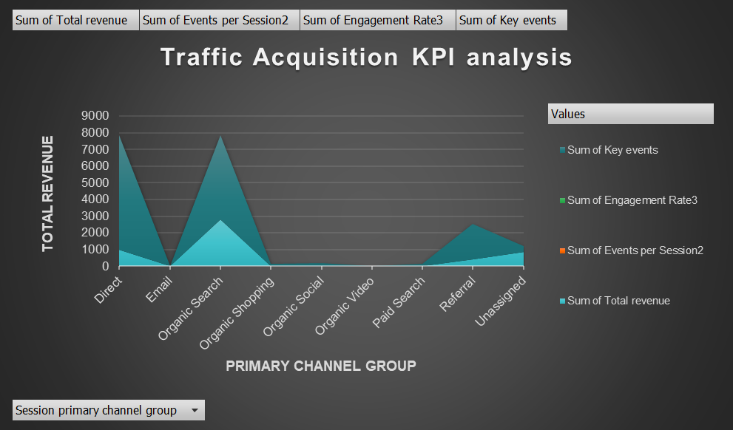
Traffic acquisition kpi analysis

Slide 7
📊 Key Insights:
📈 Direct and Organic Search channels drive the highest total revenue, indicating strong traffic quality.
Organic Shopping shows the highest key events, suggesting highly engaged users despite moderate revenue.
📉 Email, Organic Video, and Paid Search contribute negligible traffic and revenue, indicating low effectiveness.
Referral performs moderately well across all metrics—suitable for nurturing leads.
Engagement Rate and Events per Session are visibly significant only in a few channels (Organic Shopping, Referral).

Slide 8
💡 Recommendations:
Boost investment in Direct and Organic Search—these are high-performing channels for revenue.
Leverage Organic Shopping for its strong engagement—optimize it for conversions.
Minimize focus on low-performing sources like Email, Paid Search, and Organic Video.
Track Referral effectiveness further—it may offer scalable potential with refinement.

Slide 9
📊 Essential KPIs & Metrics to Display

Slide 10
📌 Key Performance Insights:
Channel 3 shows:
  Highest CTR (98.96%) and Conversion Rate (98.96%).
  Highest ROI (₹420.01) → Most effective and profitable channel.
Channel 1:
  Moderate CTR (18.17%) and Conversion Rate (18.17%).
  Positive ROI (₹337.92) → Good engagement with strong returns.
Channels 2, 4, and 5:
  Low ROI (−₹100) → Unprofitable.
  Moderate CTR and Conversion Rates, but not cost-effective.
  Need optimization or reconsideration in the campaign mix.
CPC Comparison:
  Highest Cost per Click observed in Channels 2 and 3.
  Yet, ROI justifies cost for Channel 3, not others.

Slide 11
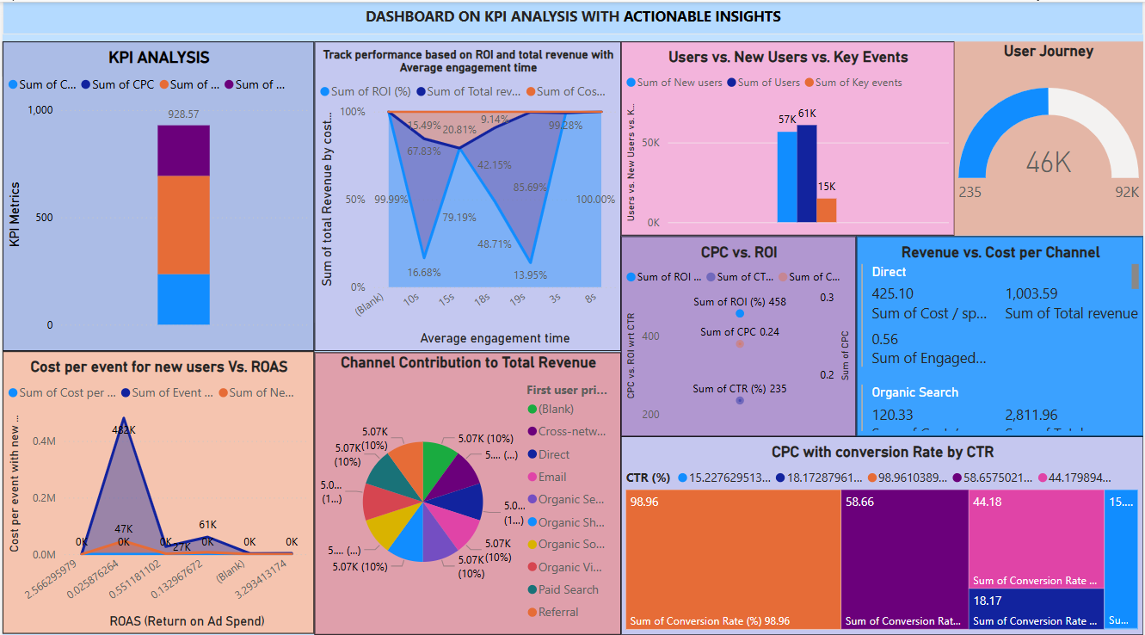
detailed dashboard, Analytics and reports for stakeholders

Slide 12
🔍 Key Insights from KPI Dashboard
📊 1. Overall KPI Performance
Highest total Cost is ₹928.57, with CPC, CTR, and Conversion Rates stacked.
ROI and Cost efficiency vary sharply by channel and engagement time.
👥 2. Users vs. New Users vs. Key Events
New users (61K) outnumber returning users (57K), indicating strong acquisition.
Key events (~15K) show room for improving user engagement post-acquisition.
🕒 3. ROI vs. Avg. Engagement Time
Peak ROI (99.99%) occurs with 10s engagement.
Drop in ROI at 25s–35s, suggesting overexposure may reduce efficiency.

Slide 13
Cont.,
💸 4. Cost per Event for New Users vs. ROAS
Sharp spike in cost at low ROAS; inefficient ad spend at some touchpoints.
Campaigns with 0.5+ ROAS show better event conversion per rupee.
📈 5. CPC vs. ROI
Inverse trend: Lower CPC yields higher ROI.
CPC around ₹0.24 achieves 458% ROI, ideal for cost-effective scaling.
🧩 6. Revenue vs. Cost per Channel
Organic Search drives highest revenue (₹2,811.96) at controlled cost.
Direct traffic shows high cost (₹1,003.59) but moderate ROI, needs optimization.

Slide 14
Cont.,
🥧 7. Channel Contribution to Total Revenue
All channels contribute equally (10%) visually, but actual revenue varies.
Cross-channel synergy is evident; optimization possible in Organic Video & Social.
📦 8. Conversion Rate & CTR Correlation
Best CTR (98.96%) aligns with highest Conversion Rate (also 98.96%).
Channels with CTR > 40% consistently outperform in conversions.

Slide 15
🔍 Actionable Insights & Recommendations
1. 📈 High ROI Opportunities via Organic Search
Insight:
Organic Search generated the highest revenue (₹2,811.96) at a controlled cost, with strong CTR and engagement.
Recommendation:
✅ Double down on SEO investment.
Focus on content optimization, keyword targeting, and technical SEO to increase inbound traffic at low cost.
2. 🧾 High Ad Spend, Low Returns from Direct Traffic
Insight:
Direct channel had the highest cost (~₹1,003.59) but relatively low ROI (425.10 revenue).
Recommendation:
⚠️ Audit Direct traffic sources.
Ensure tracking is accurate and investigate if this traffic includes misattributed paid sources. Shift budget from low-performing direct efforts to higher ROI channels.

Slide 16
Cont.,
3. 💸 CPC Drives ROI Inversely
Insight:
Channels with lower CPC (₹0.24) achieved high ROI (458%).
Channels with CPC > ₹0.50 had lower ROI and high bounce rates.
Recommendation:
✅ Reallocate budget toward high-ROI, low-CPC campaigns.
Continuously monitor and A/B test ads to lower CPC without compromising CTR.
4. 🚀 Strong Acquisition, Weak Retention
Insight:
New users (61K) significantly outweigh returning users (57K), but only 15K key events observed.
Recommendation:
🎯 Invest in post-acquisition engagement strategies such as onboarding flows, remarketing, and email nurturing to convert new users into active ones.

Slide 17
Cont.,
5. 🕒 ROI Correlated with 10s Avg. Engagement Time
Insight:
Highest ROI observed at 10s engagement time, then drops off.
Recommendation:
✅ Refine landing pages and CTAs to capture user attention and drive action within the 10–15 second window.
6. 📊 Balanced Channel Contribution Visually, But Not in Value
Insight:
Dashboard pie chart suggests equal contribution from channels, but actual revenue skews heavily toward Organic and Referral.
Recommendation:
📈 Use weighted visualizations in reporting.
Clearly highlight top contributors in value terms, not just channel presence.

Slide 18
Cont.,
7. 🎯 CTR Aligns Strongly with Conversion Rate
Insight:
CTR of 98.96% resulted in the highest conversion rate (also 98.96%), showing a direct positive correlation.
Recommendation:
✅ Boost creatives and ad messaging in underperforming channels by borrowing from high-CTR campaigns.
8. 🛑 Inefficiency in Some Cost-Heavy Campaigns
Insight:
Certain channels show high cost per event with low ROAS, indicating budget wastage.
Recommendation:
⚠️ Pause or restructure underperforming campaigns.
Reevaluate targeting, bidding strategy, and channel relevance.

Slide 19
🚀 Campaign Performance Summary
Organic Search: Top performer in revenue with low cost and high ROI.
Direct Traffic: Highest spend, but underwhelming returns.
New Users: High acquisition (61K) but low key event engagement (15K).
CTR & Conversion: Strong positive correlation – high CTR leads to high conversions.
ROI Peaks at 10s Engagement: Short engagement windows drive results.

Slide 20
📊 Key Insights
Low CPC channels generate highest ROI.
High spend on low-ROAS channels is reducing efficiency.
User retention and conversion funnel need reinforcement.
Engagement drops after 10–15 seconds – critical to act early.

Slide 21
✅ Recommendations
Invest more in SEO & Organic Search – best cost-to-revenue ratio.
Optimize Direct campaigns – audit and reduce spend if underperforming.
Enhance creatives and CTA to improve CTR and conversion.
Boost post-click engagement (onboarding, retargeting, remarketing).
Focus on 10s engagement window – strong messaging & fast-loading pages.
Pause or fix costly, low-ROI channels – reallocate to performing ones

